Slide 1
PEV112
Verbal Ability

Slide 2
UNIT 1(Lecture-1)
Errors based on parts of speech

Slide 3
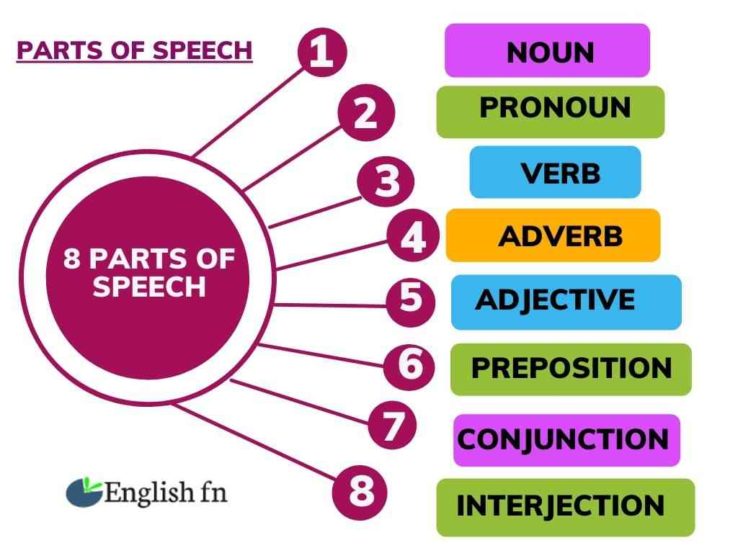
ERRORS IN PARTS OF SPEECH

Slide 4
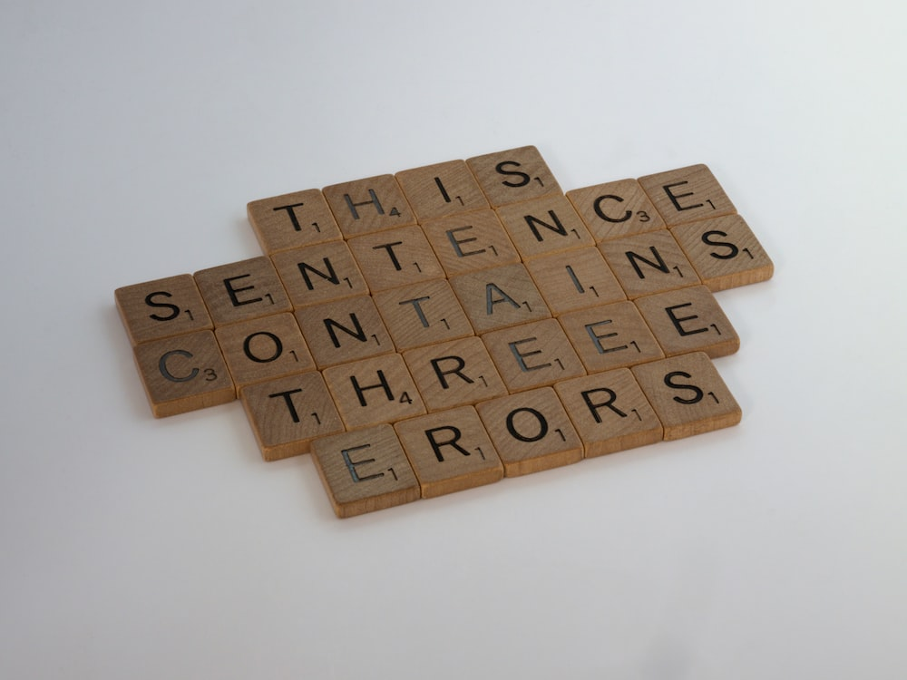

Slide 5
Errors related to parts of speech are mistakes that people make with the words they use. These mistakes can happen when people are speaking or writing. There are many different types of errors. Let’s take a closer look at each one.
Common Noun Errors
Definition of Noun –
Nouns make up the largest class of words in most languages, including English. A noun is a word that refers to a thing (book), a person (Noah Webster), an animal (cat), a place (Omaha), a quality (softness), an idea (justice), or an action (yodeling). It's usually a single word, but not always: cake, shoes, school bus, and time and a half are all nouns.

Slide 6
1. The nouns such as Poetry, Scenery, Advice, Bread, Luggage, Stationery, Cutlery, Furniture, Baggage, etc. are always used in singular form and take singular verbs –
e.g. The Furniture of the house is beautiful.
The Poetry of Keats is sensual.
2. The following nouns look plural due to their structure, but in reality they are singular and take singular verbs with them –
The nouns are – News, Politics, Physics, Statistics, Ethics, Economics etc.
e.g. This news is not good.
Note – But if we use the or Possessive Adjectives (My, Your, our etc.) before them, they are used as plural and take plural likewise.
e.g. My mathematics are very good.
Here mathematics is not a subject but the power of calculation.

Slide 7
3. The Nouns such as Sheep, Deer, Cattle, Gentry, Poultry, Folk, People, Cavalry, Police, Infantry etc. are used only as plural nouns and carry plural verbs with them.
e.g. The Cattle are grazing in the field.
The Police have arrested the thief.
4. The nouns such as Committee, Jury, Council, Team, Opposition, Club, Choir, Orchestra etc are used as singular if taken as Collective Nouns. But if the same nouns are used as Nouns of Multitude they are considered plural and take plural verbs.
e.g. The team has given a very good performance. (Unity)
The team are fighting like street boys
Common Errors – Rules of Nouns

Slide 8
5. If the structure – Any Singular Noun + Preposition + Same Noun is given. it is followed by singular verb –
e.g. Man after man is being killed.
In this structure only Singular nouns shall be used at both the positions.
6. The nouns such as Wood, Brick, Stone, Glass etc. are generally used as uncountable nouns –
e.g. This house is made of brick.
7. When stone is used for weight, it remains same. But when it comes for other meaning, it can have its plural.
For Example –
Diamond and Emerald are precious stones.
He weighs only 10 stone.
8. Use of Yoke –
Yoke means A piece of wood placed on the necks of oxen. It remains unchanged as plural or singular. But it can take a, one, two, three etc. before it.
A yoke, Two yoke etc.

Slide 9
9. Use of Brother –
It has two plurals. Brothers and Brethren. When there is the blood relationship, it is brothers and when it is used in the general sense, it is brothers. e.g.
Ram and Sam are brothers.
All Indians are brethren.
Learn Some more usage of Nouns –
Use of People –
People are not good here. (Group of persons)
The French are an old people (Tribe, Community)
Peoples of Europe and the USA are friends. (People of two different places)

Slide 10
Use of Wood –
This table of made of wood. (Material)
There is a woods near our village. (Forest)
Common Errors regarding the Use of Nouns –
Use of Abuse –
He showered abuse on me. (Called me names)
He showered abuses on me. (Evils)
Social reformers tried to do away many abuses prevalent in society. (Evils)
Use of Pain –
He has pain in his tooth.
He took pains to educate his children. (Make great efforts)

Slide 11
.
Choose the correct option.
1. My father always brings home two dozens / dozen apples. 2. Unfortunately the new scissor / scissors I have purchased are blunt. 3. Without a doubt the scenery / sceneries in Kashmir are extremely lovely. 4. I am a vegeterian and thankfully I love fruit/ fruits and vegetables. 5. Though he is still in his twenties his hair/ hairs has gone grey.
6. This sturdy building has been made out of brick / bricks and mortar.
7. He ran an amazing ten mile / ten miles race and bagged the trophy. 8. Politics, without any doubt, is / are today a game for scoundrels.
9.He badly needs two pairs / pair of boots.
10. He narrated the story superbly in great detail /details

Slide 12
.
.
CORRECT ANSWERS
1.dozen 9.pairs
10.detail
2.scissors
3.scenery
4.fruit
5.hair
6.brick
7.ten mile
8. is

Slide 13
Common Pronoun Errors
Definition of Pronoun
Pronouns replace nouns with words like she, they, your, their, it, and others. See the following sentences:
No pronoun: Employees can view the employees’ paychecks online.
Pronoun: Employees can view their paychecks online.
In the first sentence, no pronoun is used. In the second sentence, the pronoun ‘their’ is used to replace the word employees’. Let’s look at two more sentences:
No pronoun: My computer broke, so tech support fixed my computer.
Pronoun: My computer broke, so tech support fixed it.
Notice that the second sentence uses the pronoun it to refer to computer. The pronoun makes the sentence more concise. As you can see, pronouns can be useful. Now, let’s study some guidelines about how to use pronouns correctly.

Slide 14
Principle 1: Choose a pronoun based on the audience and the formality of the situation.
Sometimes writers want to express an idea about people in general. For example, the writer may want to share advice or state a fact. The formal way to do that is to use the pronoun one, which means “a person.” See the example below:
If one wants to achieve a dream, one must make a goal.
The example sentence above is correct for formal situations. However, sometimes using the pronoun one can be too formal. In informal situations, it may be better to use the pronoun you. See the example below:
If you want to achieve a dream, you must make a goal.
However, it can be rude to use the pronoun you too often in sentence, because it can seem like the writer is accusing or pointing a finger. Look at the following sentences:
Accusing: When you understand this system, you can increase your production.
Better: When people understand this system, they can increase their production.
Notice that the “better” sentence had a different way to make a general statement. The writer used the noun people and the pronoun they, and it did not seem as rude as the “accusing” sentence.
Remember that deciding which pronoun to use depends on the audience and the formality of the situation.

Slide 15
Principle 2: A pronoun must agree in number with the noun it replaces.
When using a pronoun, be sure it agrees in number with the noun it refers to. Let’s look at the following sentence:
Incorrect: I hate it when a customer doesn’t know what they want.
In the sentence above, the noun customer is singular. However, the pronoun they, used later in the sentence, is plural. Let’s look at the correction of that sentence:
Correct: I hate it when customers don’t know what they want.
In the correct sentence, the writer changed the noun to be plural, which made it easier to express the idea and ensure that the noun and pronoun would agree in number.
Principle 3: Avoid using “he” and “she” when expressing general ideas.
Do not refer to one gender when writing about people in general. This mistake happens a lot when a writer refers to a particular activity or profession. See the sentence below:

Slide 16
Incorrect: A good doctor will always listen to his patients.
The pronoun in the sentence above is incorrect because it expresses the idea that all doctors are male, which is not true. Let’s look at a correction:
Correct: Good doctors will always listen to their patients.
The writer of the correct sentence made the noun and pronouns plural so that they refer to all people, not just one gender.
Principle 4: Ensure each pronoun matches the type of noun that it replaces.
Be sure the pronoun you use correctly matches the noun it replaces. Use the pronoun who when referring to people, that when referring to things, when when referring to time, and where when referring to places. See the following example:
Incorrect: I know a woman that can type 80 words per minute.
Correct: I know a woman who can type 80 words per minute.
In the incorrect sentence, the writer used the pronoun that to replace the noun woman. Since woman is a person, the correct pronoun in this sentence is who.
Principle 5: Use a pronoun only if it is clear which noun the pronoun replaces.

Slide 17
Remember that a pronoun replaces a noun, so be sure it is clear which noun the pronoun replaces. Look at the following passage:
Unclear: All of the patients arrived late for their appointments, and I missed my lunch hour. This made me upset for the rest of the day.
In the sentence above, it is not clear what this refers to. Was the employee upset because the patients arrived late or because he missed lunch? Was he upset because of both situations? It is not clear. See the correction below:
Better: All of the patients arrived late for their appointments, and I missed my lunch hour. Missing lunch made me upset for the rest of the day.
In the correction, the writer makes it clear which situation made him feel upset. In this passage, it was best to not use a pronoun.

Slide 18
Pronoun Exercises with Answers | Spotting Errors
Let ……………..go to the movie today. (we, us)
I know the woman ……………..child was hurt. (who, whose, whom)
……………..have you got in your pocket? (which, what)
Take anything…………you like. (which, that)
……………..can I do for you? (what, which, that)
This room is for you and ……………. (me, myself)
He behaved in such a manner ………….. I had never hoped. (that, as, which)
…………..are you asking about? (who, whom, which)
Behind ………………….and ……………were many seats. (he, him, I, me)
Neither she nor they have brought …………books. (her, their)

Slide 19
Check Your Answers
Let us go to the movie today. (we, us)
I know the woman whose child was hurt. (who, whose, whom)
What have you got in your pocket? (which, what)
Take anything that you like. (which, that)
What can I do for you? (what, which, that)
This room is for you and me. (me, myself)
He behaved in such a manner as I had never hoped. (that, as, which)
Who are you asking about? (who, whom, which)
Behind him and me were many seats. (he, him, I, me)
Neither she nor they have brought their books. (her, their)

Slide 20
Errors Related to Verbs in a Sentence
Definition of Verb
Verbs are words that show an action (sing), occurrence (develop), or state of being (exist)
Verb tense errors
Verb tense error is one of the most common errors made when it comes to verbs. It is the use of the wrong verb in a sentence. Tenses are important because they tell the time of an action or event. If the tense of the action is wrong, it will send the wrong message. To avoid this error, you must be sure of the tense and write it down correctly to pass the right message across.
For example:
I am going to the store to bought milk
Have you did your chores?
She always swept the class when she comes in the morning.
The correct sentences are:
I am going to the store to buy some milk.
Have you done your homework?
She always sweeps the class when she comes in the morning.

Slide 21
Subject-Verb agreement errors
The subject-verb agreement error has to do with the mismatch of the subject with the verbs. This means that the verb tense does not match the number of the subject in the sentence. Let’s look at a few rules to keep in mind to avoid the subject-verb agreement error:
1. If the subject (i.e. is, has, was) is singular, then the verb must be singular. If the subject is plural (i.e. are, have, were) the verb must be plural.
For example,
He sleeps, they sleep
2. If the word joins two subjects, then the verb must be plural.
For example,
Sean and I are skating
3. Two subjects that are joined with neither…nor, either…. or etc. will agree with the nearest subject.
For example,
Neither Stephen nor James came home early
Either my siblings or my best friend could have done this.

Slide 22
4. A proper noun in plural form takes a singular verb.
For example,
Measles is common among children.
Mathematics is dreaded by many students.
Here are some examples of disagreement verb errors:
The boys loves sandwiches
My mother and I is going to the market
Hilda eat lunch by1 pm every day
The correct sentences are:
The boys love sandwiches
My mother and I are going to the market
Hilda eats lunch by 1pm every day.

Slide 23
Conclusion
A verb is a part of speech that describes actions and state of being. There are many types of verbs. The most common are regular, irregular, main, and auxiliary verbs. Verb errors are caused by mistakes in tenses and subject-verb agreement. There are rules to note to avoid these errors.

Slide 24
Choose the correct option.
1. Everybody have/ has to work.
2. Every boy and every girl have/ has got a book.
3. Each boy was / were present.
4. Each of the boys plays / play cricket.
5. Each of them have/ has gone.
6. Neither Ram nor Rahim are / is present in the meeting.
7. Neither Ajoy nor his brothers is /are present.
8. None of them was / were present in the meeting.
9. Ram as well as his brothers has / have come.
10. It is you who has / have done wrong.

Slide 25
ANSWERS
1.has
2. has
3.was
4. plays
5.has
6. is
7. are
8. was
9. has
10. have

